Slide 1
Basics in R Workshop
Presentation by Cassandra Richardson and Angelina Venetto

Slide 2
What is R?

Slide 3
R
R is a free, open-source software for statistical computing and graphics from CRAN, the Comprehensive R Archive Network
Uses
Statistics
Data analysis
Data visualization
Machine learning
App and website development

Slide 4
Why do people use R vs. SAS or SPSS?
 | R | SAS | SPSS
Pros | Free Most commonly used Large collection of packages for various fields/industries Easy, customizable data visualization Strong community support | SAS is secure, preferred when using sensitive or confidential data Scalable and stable software, allowing very large datasets | Easy to use; minimal coding Quick and easy analysis
Cons | R is not secure Steep learning curve; requires coding Not ideal for very large datasets | Required to purchase expensive license Less data visualization and graphing capabilities | Required to purchase expensive license Limited data storage; not ideal for very large datasets Limited functions

Slide 5
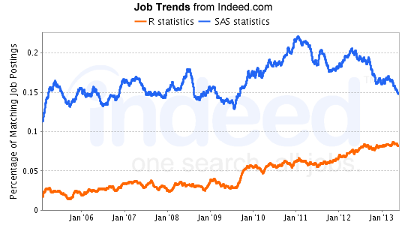
The Value of Learning R
We are in a “data heavy” world, putting data science skills in high demand.
Developing statistical analysis and visualization skills increases chances of graduate school acceptance, employment, and higher salaries.
From Dr. Paul Atchley:
“Even basic knowledge of statistical analysis and skills using tools like SPSS, SAS or the highly sought after skill of the ability to use R to perform statistical analysis can put your name at the top of a list for many jobs.”
Notes:
https://blog.revolutionanalytics.com/2013/08/job-trends-for-statistics-packages.html

Slide 6
Getting Started With R

Slide 7
Downloading R and RStudio
Install R 4.1.3
https://cran.r-project.org/bin/windows/base/
Make sure you are using the most updated version!
This is the software that performs the functions
The “interpreter”
Install RStudio
https://rstudio.com
This is the software that serves as an interface that you will use to write code
Notes:
https://mgimond.github.io/ES218/R_vs_RStudio.html

Slide 8
Intro to GitHub
GitHub is an online platform for your code
Allows for version control and collaboration
It is used in the way that we use Box, except GitHub is code-specific and code is saved in a single document with version history
Since we use Box in our lab, we will not be installing GitHub. However, if you want to learn R on your own, I strongly recommend using GitHub to store your codes!
Notes:
Instead of having multiple SAS codes (i.e., “Moffitt Outpatient 04-19-2022, Moffitt Outpatient 04-20-2022”) you have a single document of code, and GitHub shows all of the changes made on each date so you can revert back to previous versions

Slide 9
How do we use R and RStudio?

Slide 10
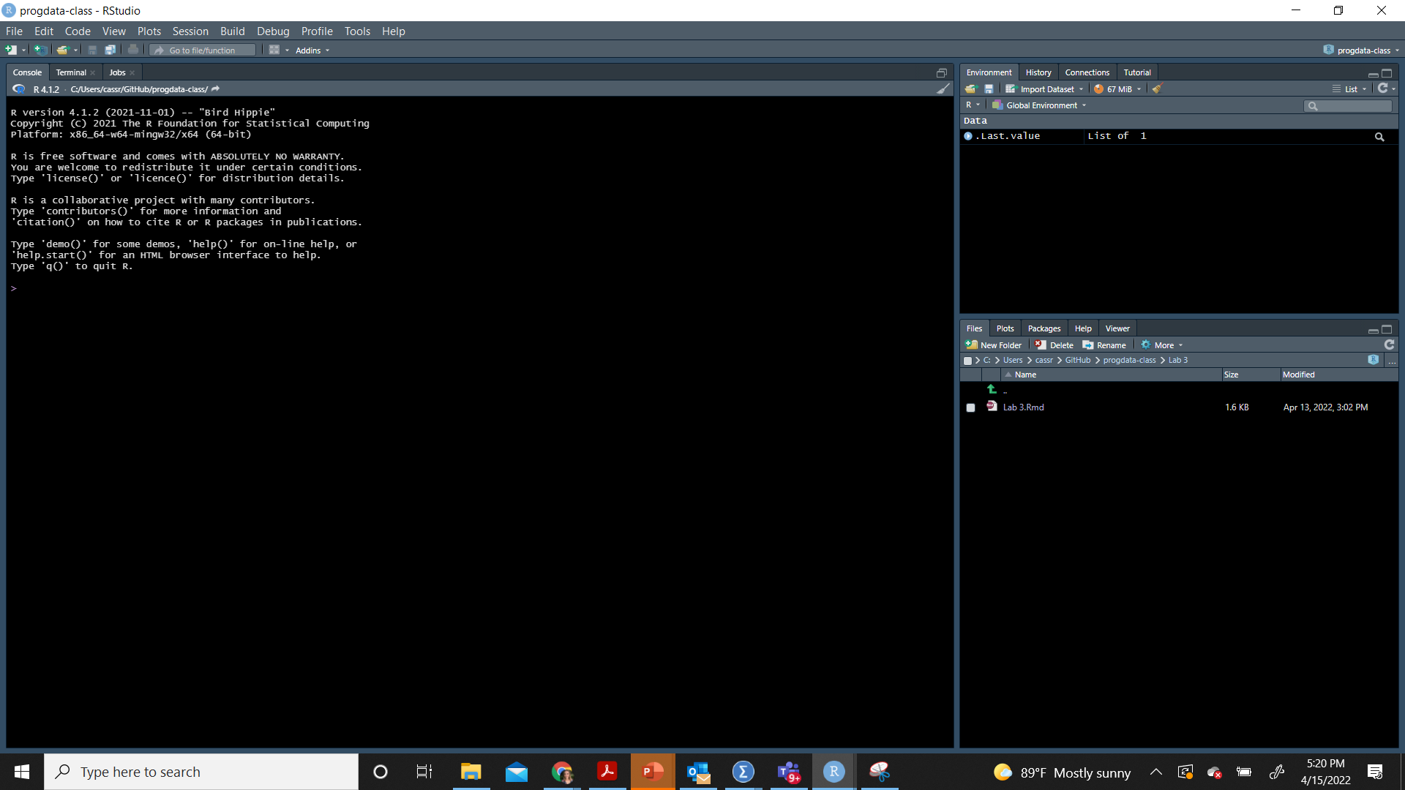
This is what RStudio looks like when you first open it. Before we break this window down, go to: File > New File > R Markdown
R Script is a file of only code
R Markdown is a file with both text and code chunks
R Markdown files can be exported to HTML to create a website, PDFs, or Word documents

Slide 11
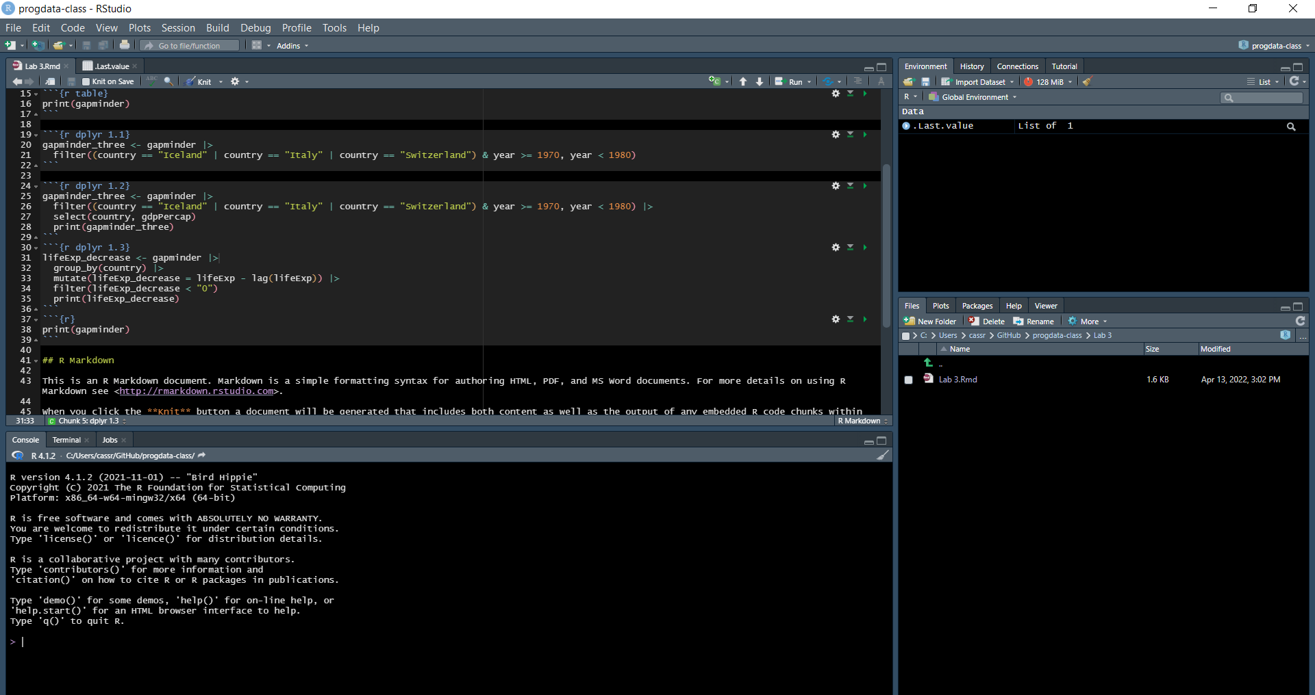
This is your Environment/History - shows what you’ve done, what objects you’ve created, and you can view your current dataset from here.
This is your R Script - this window opens when you open previously written code or start a new file of code (like the blank document you just opened).
This is your Files/Plots/Packages/Help window. Files show stored files on your computer. Plots show graphs you just made. Packages are collections of functions/data to use. Help shows you how to use the functions.
This is your Console - you can interact with R live here. You can also run code from here, but it won’t be saved.

Slide 12
Let’s Analyze! :)

Slide 13
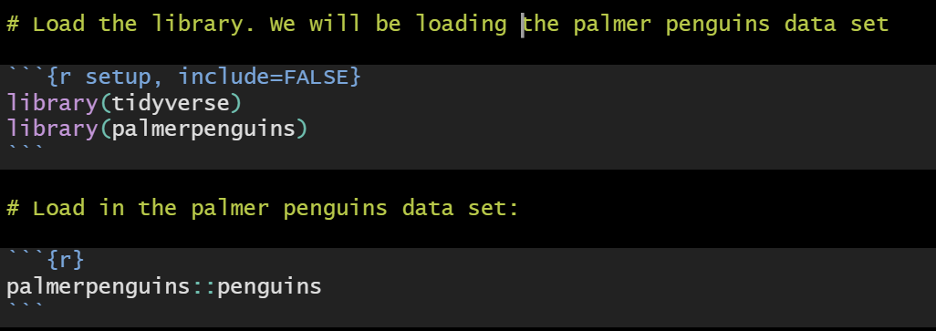
Loading in Library

Slide 14
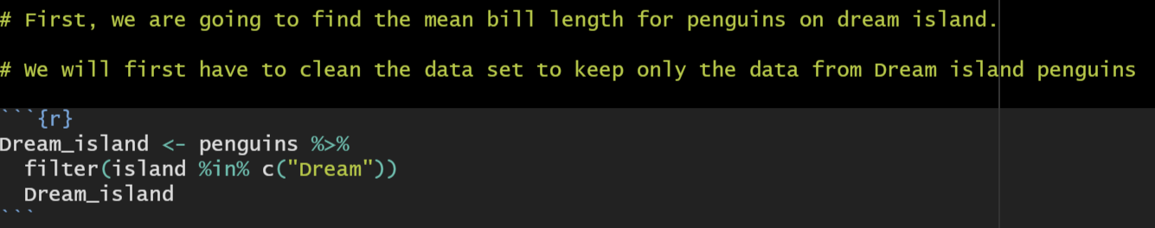
Data Cleaning :)
This is saying to set the new penguins data set as “Dream_island”
This is saying to filter the islands to only include data from Dream island
This is saying to view the new data set
“Dream_island” is the new data set
“<-” sets the object
“Filter” takes only certain variables

Slide 15
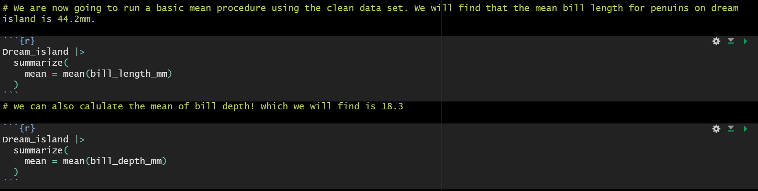
Finding the mean :)
This is saying to set the new penguins data set as “Dream_island
This is saying to filter the islands to only include data from Dream island
This is saying to view the new data set
What did you get as the mean for both bill length and depth?

Slide 16
Finding the mean :)
This is saying to set the new penguins data set as “Dream_island
This is saying to filter the islands to only include data from Dream island
This is saying to view the new data set

Slide 17
Finding the mean :)
This is saying to set the new penguins data set as “Dream_island
This is saying to filter the islands to only include data from Dream island
This is saying to view the new data set

Slide 18
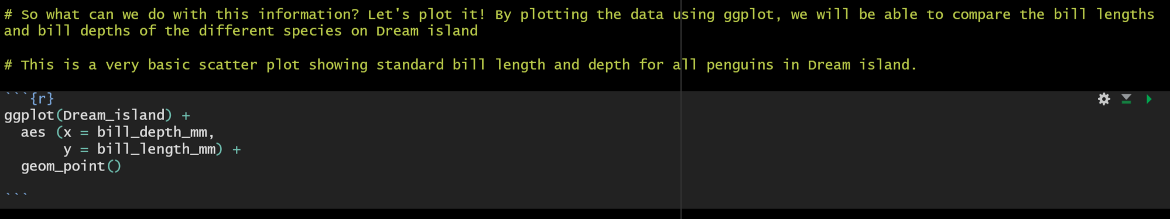
Visualizing
This is calling ggplot using the clean data set
This is altering the aesthetics (x and y axis)
This is saying to use a scatter plot
What does your plot look like?

Slide 19
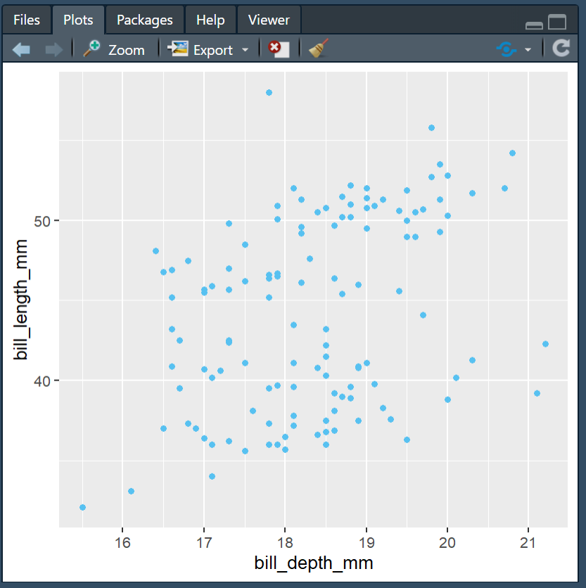
Visualizing
This is okay,
but we can do better!

Slide 20
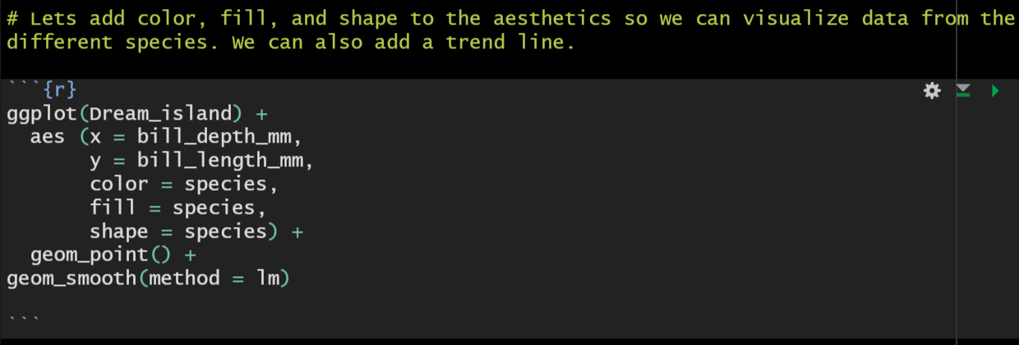
Visualizing
This is saying to add a trend line, “method = lm” is making it straight
Looking any better?

Slide 21
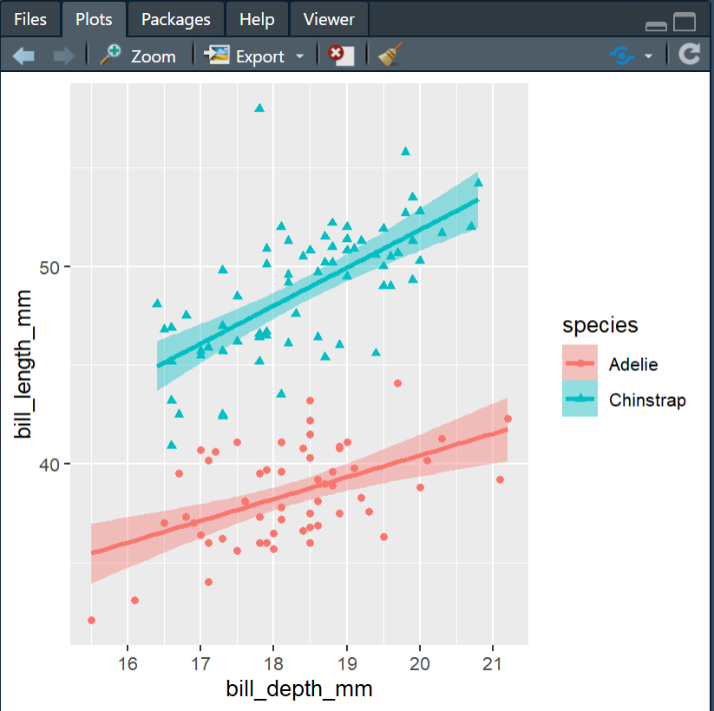
Visualizing
This is definitely better,
but let’s keep going!

Slide 22
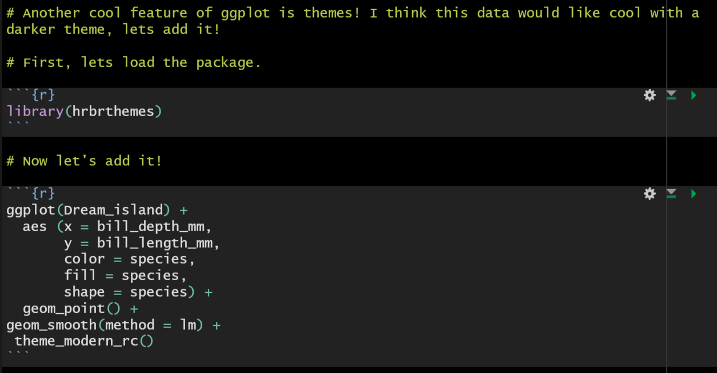
Visualizing
This is saying to add your theme!
What about now?

Slide 23
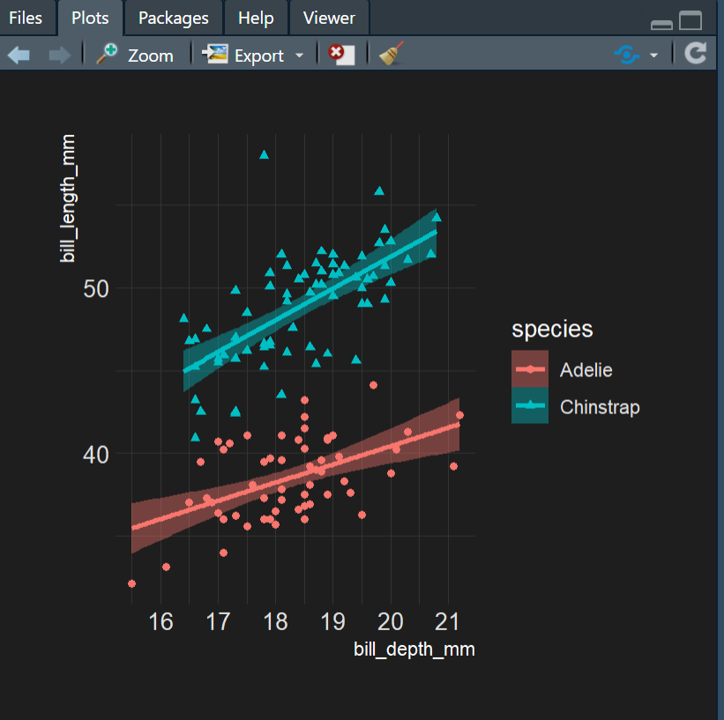
Visualizing
Looking pretty good…
just need some labels!

Slide 24
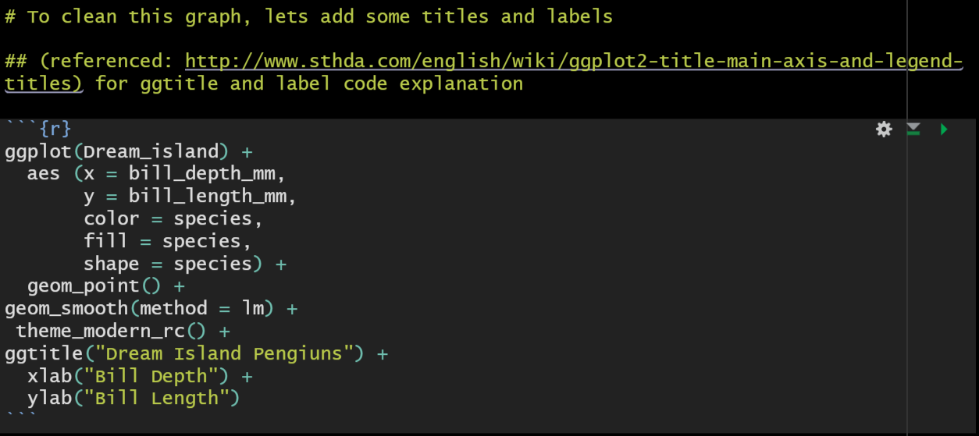
Visualizing
This is saying how to label your title and axis
I think we may have got it this time, let’s see!

Slide 25
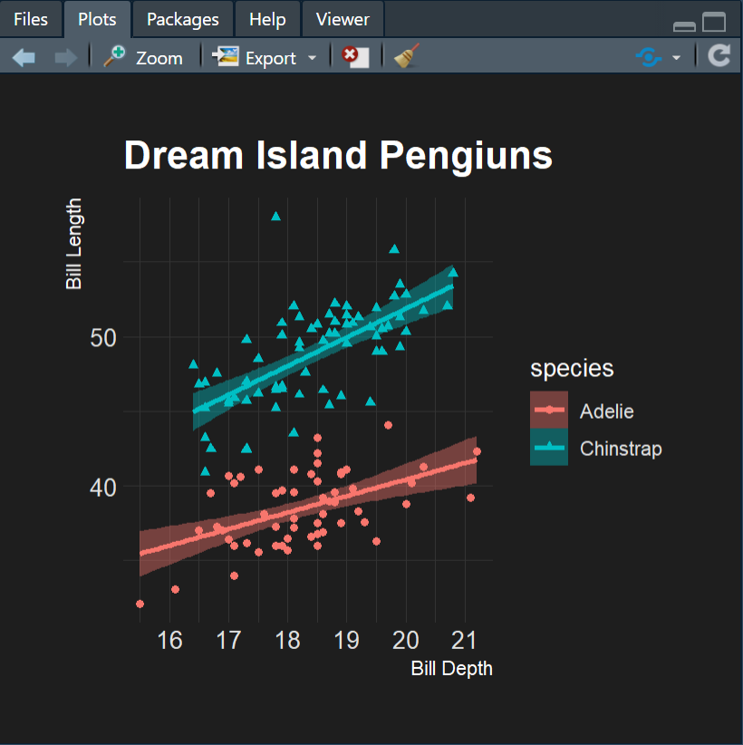
Visualizing
Finally!!
Conclusions to be drawn:
1. Dream island only has Adelie and Chinstrap penguins
2. Chinstrap penguins have much bigger bills, as they have a larger bill length and depth

Slide 26
Conclusions!
1. Dream island only has Adelie and Chinstrap penguins
2. Chinstrap penguins have much bigger bills, as they have a larger bill length and depth

Slide 27
Questions?

